Slide 1
DEEP LEARNING BASED MULTI CLASS WILD PEST DETECTION APPROACH USING MOBILENET ALGORITHM
SUBMITTED BY
BARKAVI R
II MCA-2113372037005
UNDER THE GUIDANCE OF
Dr.(Mrs.) JASMINE SAMRAJ M.Sc.,M.Phil.,B.Ed.,Ph.D.

Slide 2
ABSTRACT
This project illustrates an automatic approach for pest detection using Deep learning
The core objective of the research is to enhance feature extraction phase to improve the detection efficiency.
The proposed approach is implemented on images of fluffy caterpillar pests on mustard crop and fava bean collected from farms in kaggle web site .
The experimental results affirm the efficiency of the proposed approach.

Slide 3
INTRODUCTION
Specialized and effective pest control and monitoring in agriculture is becoming an increasingly serious issue all around the world.
Regarding the growth of the crops, One of the important factors affecting crop yield is Pest disasters.
Most wild pests are extremely similar , pest detection on field crops, is more challenging Than Object Detection
This process starts with data collection in which plant leaves images were captured using camera and after this feature extraction is performed.
This project illustrates an automatic approach for pest detection using Deep learning MobileNet Algorithm.

Slide 4
EXISTING SYSTEM
The existing system used Machine learning Algorithm.
The experiments that were carried out using these classification-based algorithms machine learning algorithm KNN, SVM, and random forest.
The existing system used Three different algorithms to Predict the pest.
Accuracy is low using these KNN,SVM and random forest algorithms.

Slide 5
PROPOSED SYSTEM
The Proposed System used Deep Learning.
Training and Testing the model is used same algorithm, but we provide different method.
The experiments that were carried out using Deep learning Mobilenet Algorithm.
Mobilenets are Faster and Smaller than other Major networks.
Accuracy is high.

Slide 6
OBJECTIVES
To Create an automatic approach for pest detection using Deep learning.
To enhance feature extraction phase.
To improve the detection efficiency.
To Create Specialized and effective pest control and monitoring in agriculture.
To learn Complex Patterns and relationship with data.
To reduce the use of pesticides and Widespread loss and damage of crops .
To demonstrate pest detection using image processing techniques.
To Focus Edge detection and strong key point extraction.

Slide 7
SYSTEM REQUIREMENTS
HARDWARE REQUIREMENTS
Hard Disk : 500 GB and above
RAM : 4 GB and above
Processor : i5 and above
SOFTWARE REQUIREMENTS
Operating System : Windows 7,8,10 (64 bit)
Software : Python
Tools : Anaconda (Jupyter notebook IDE)

Slide 8
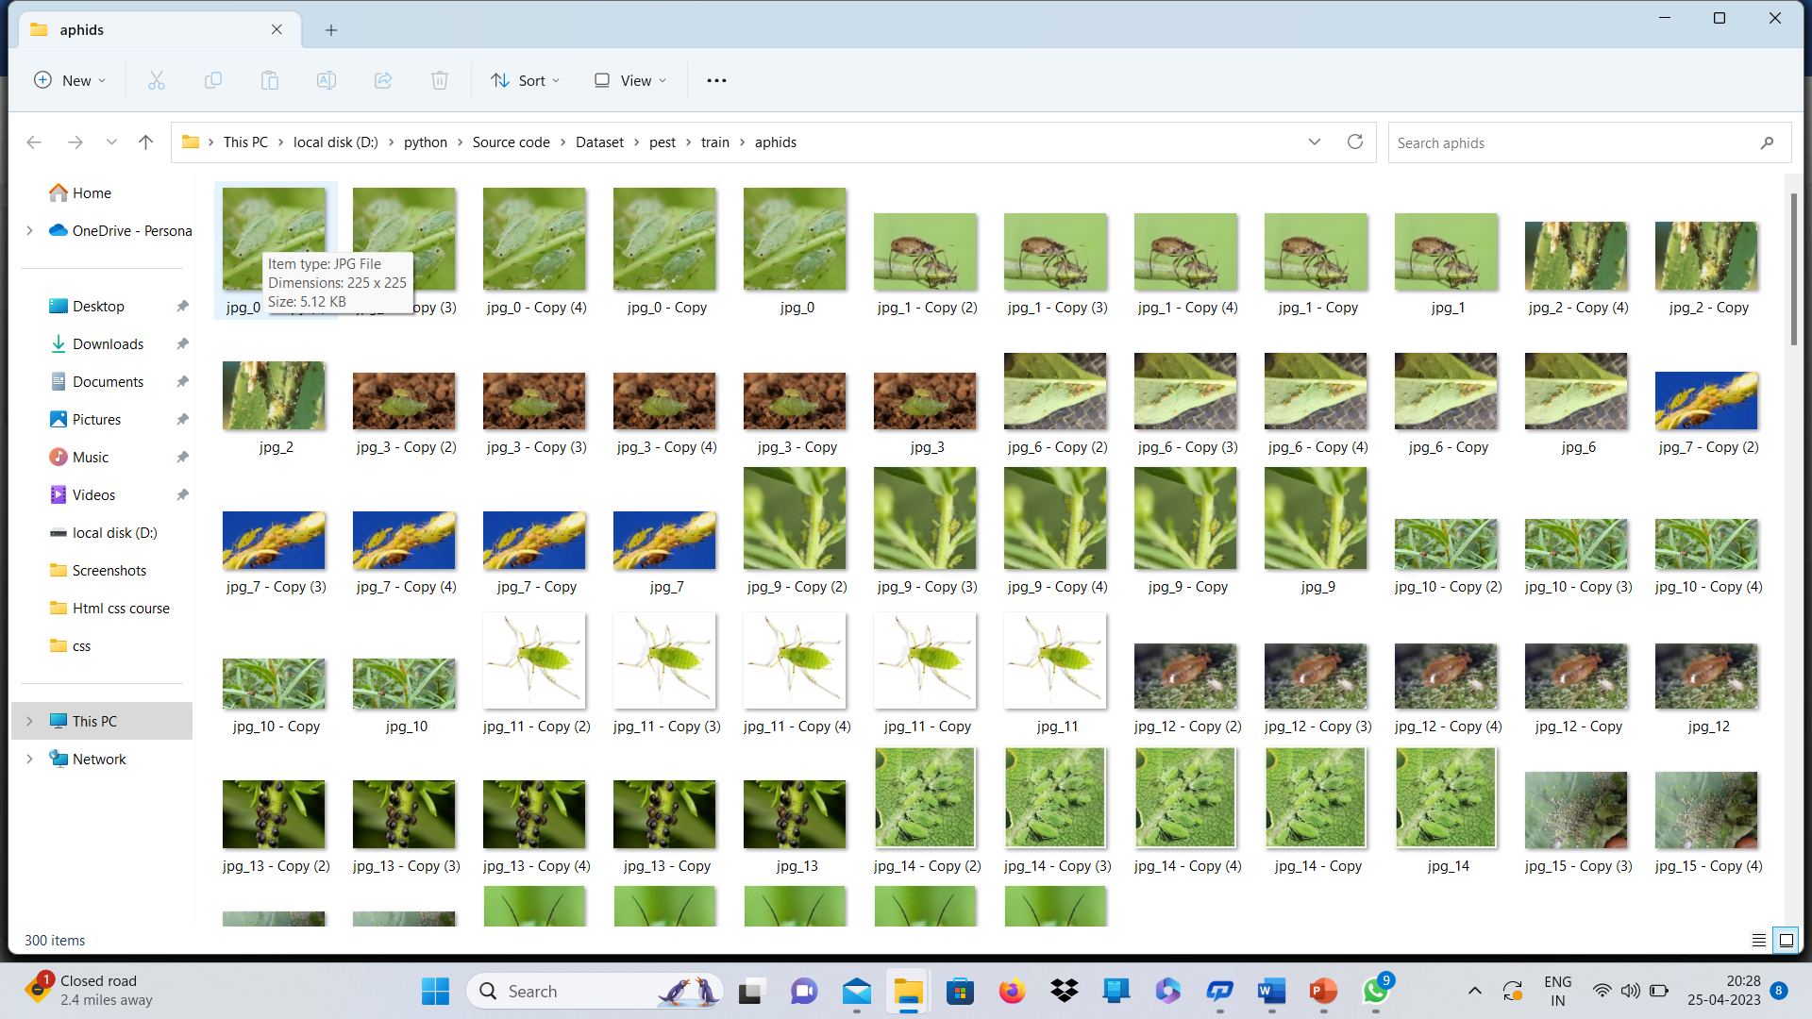
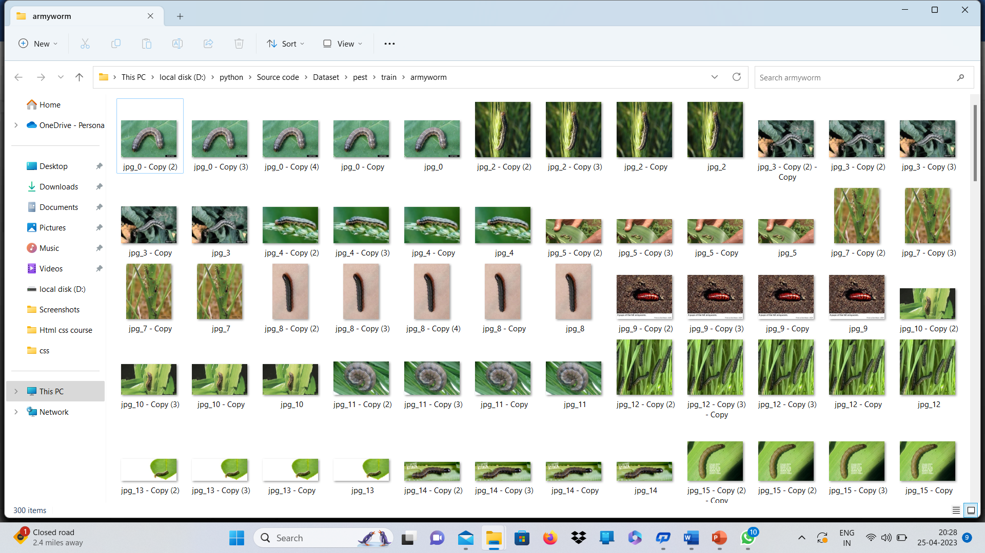
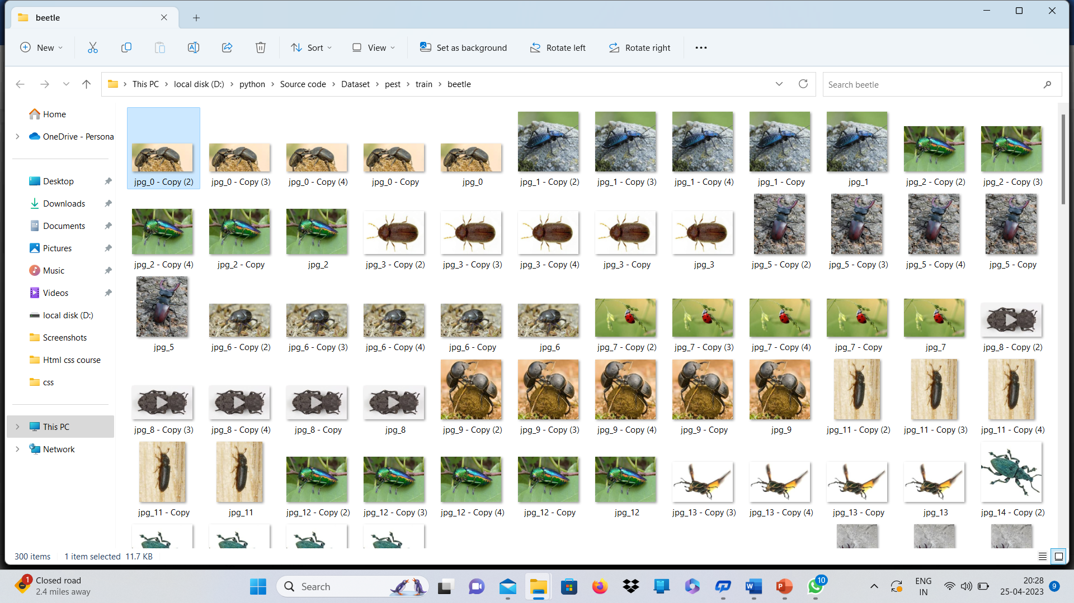
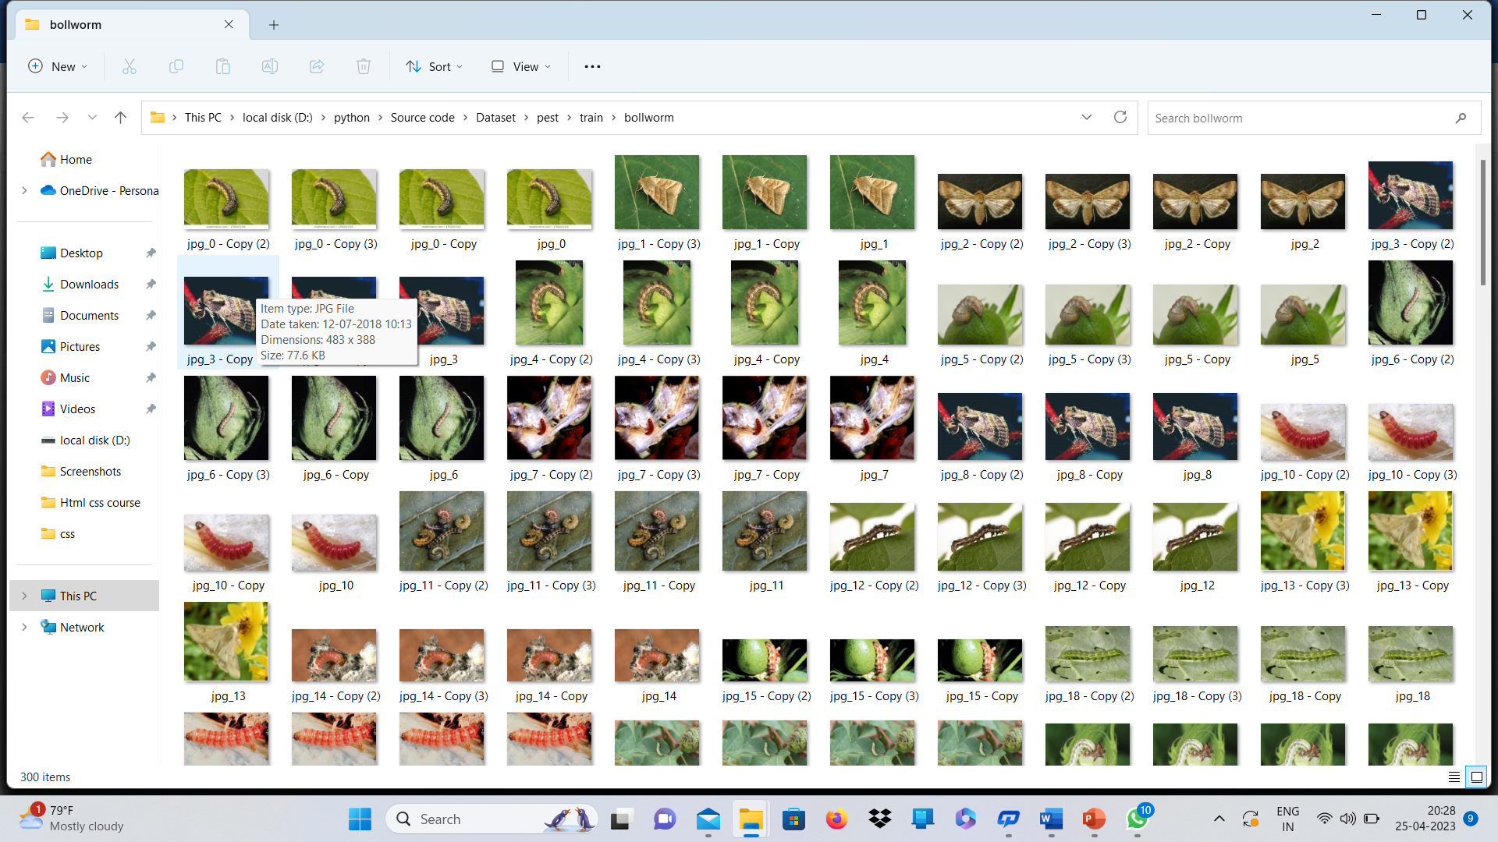
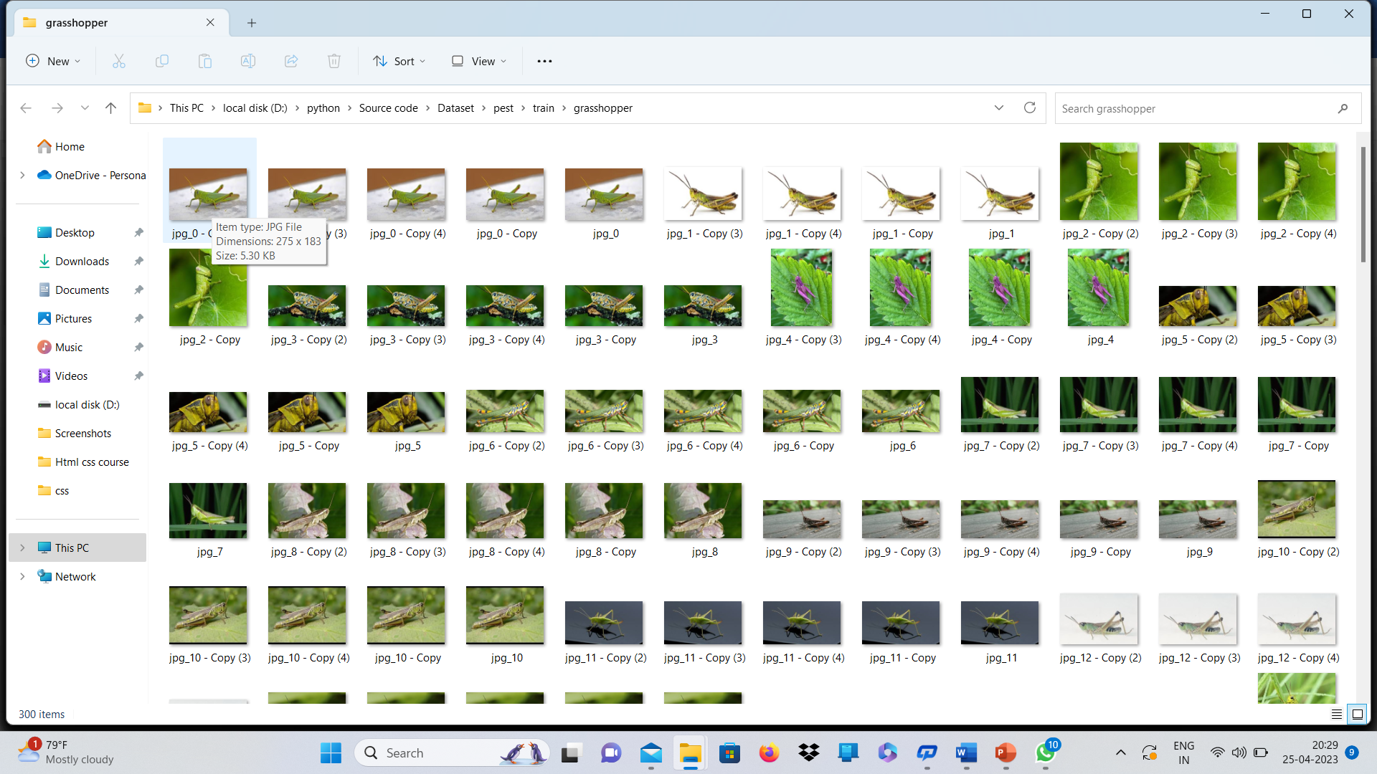
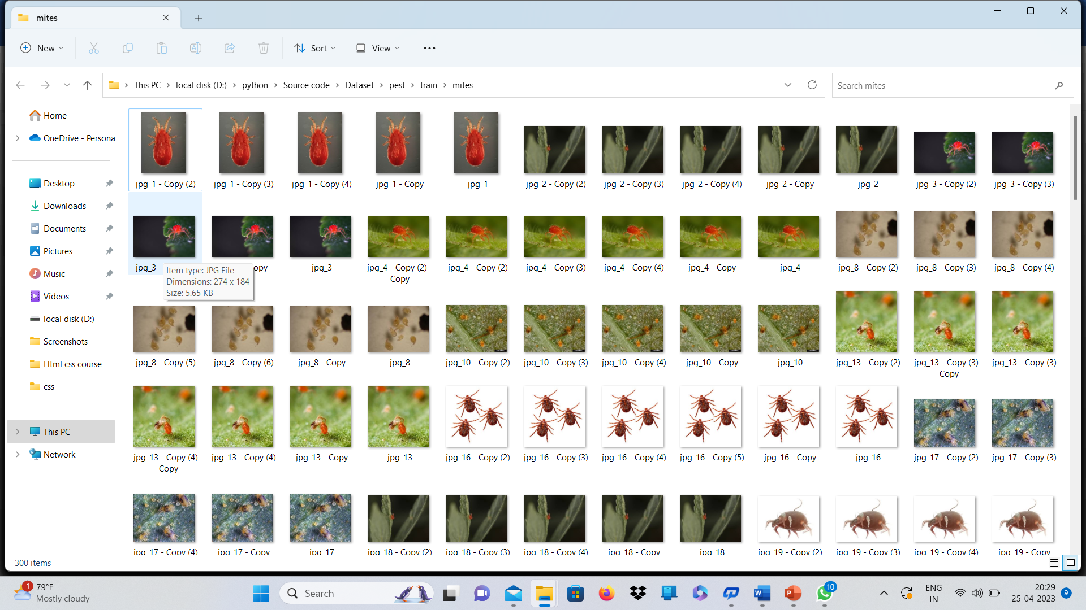
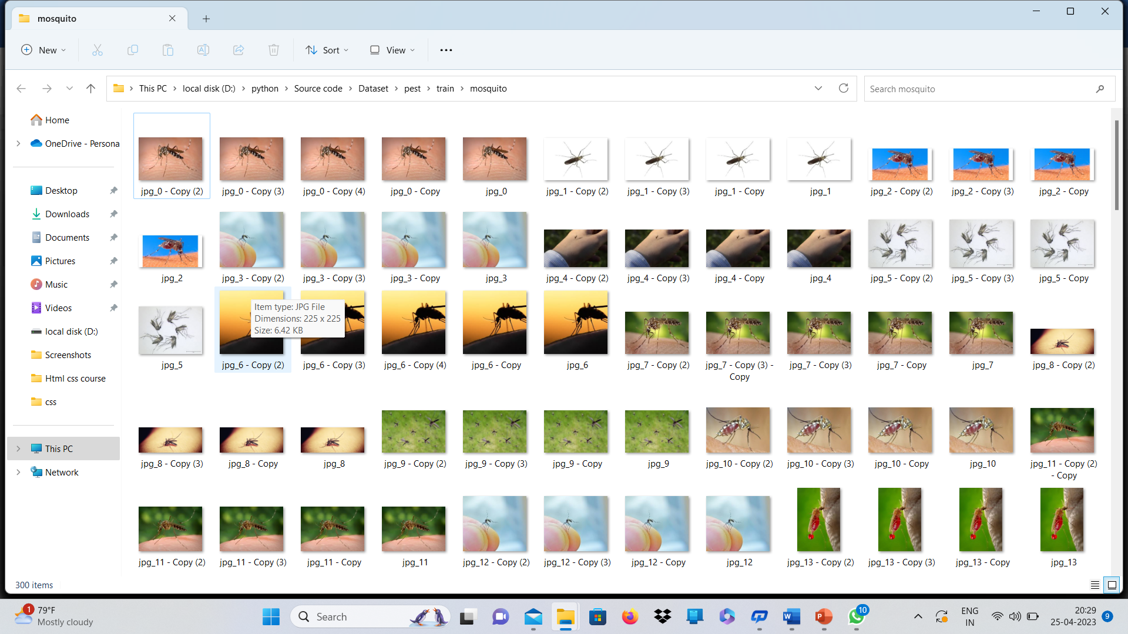
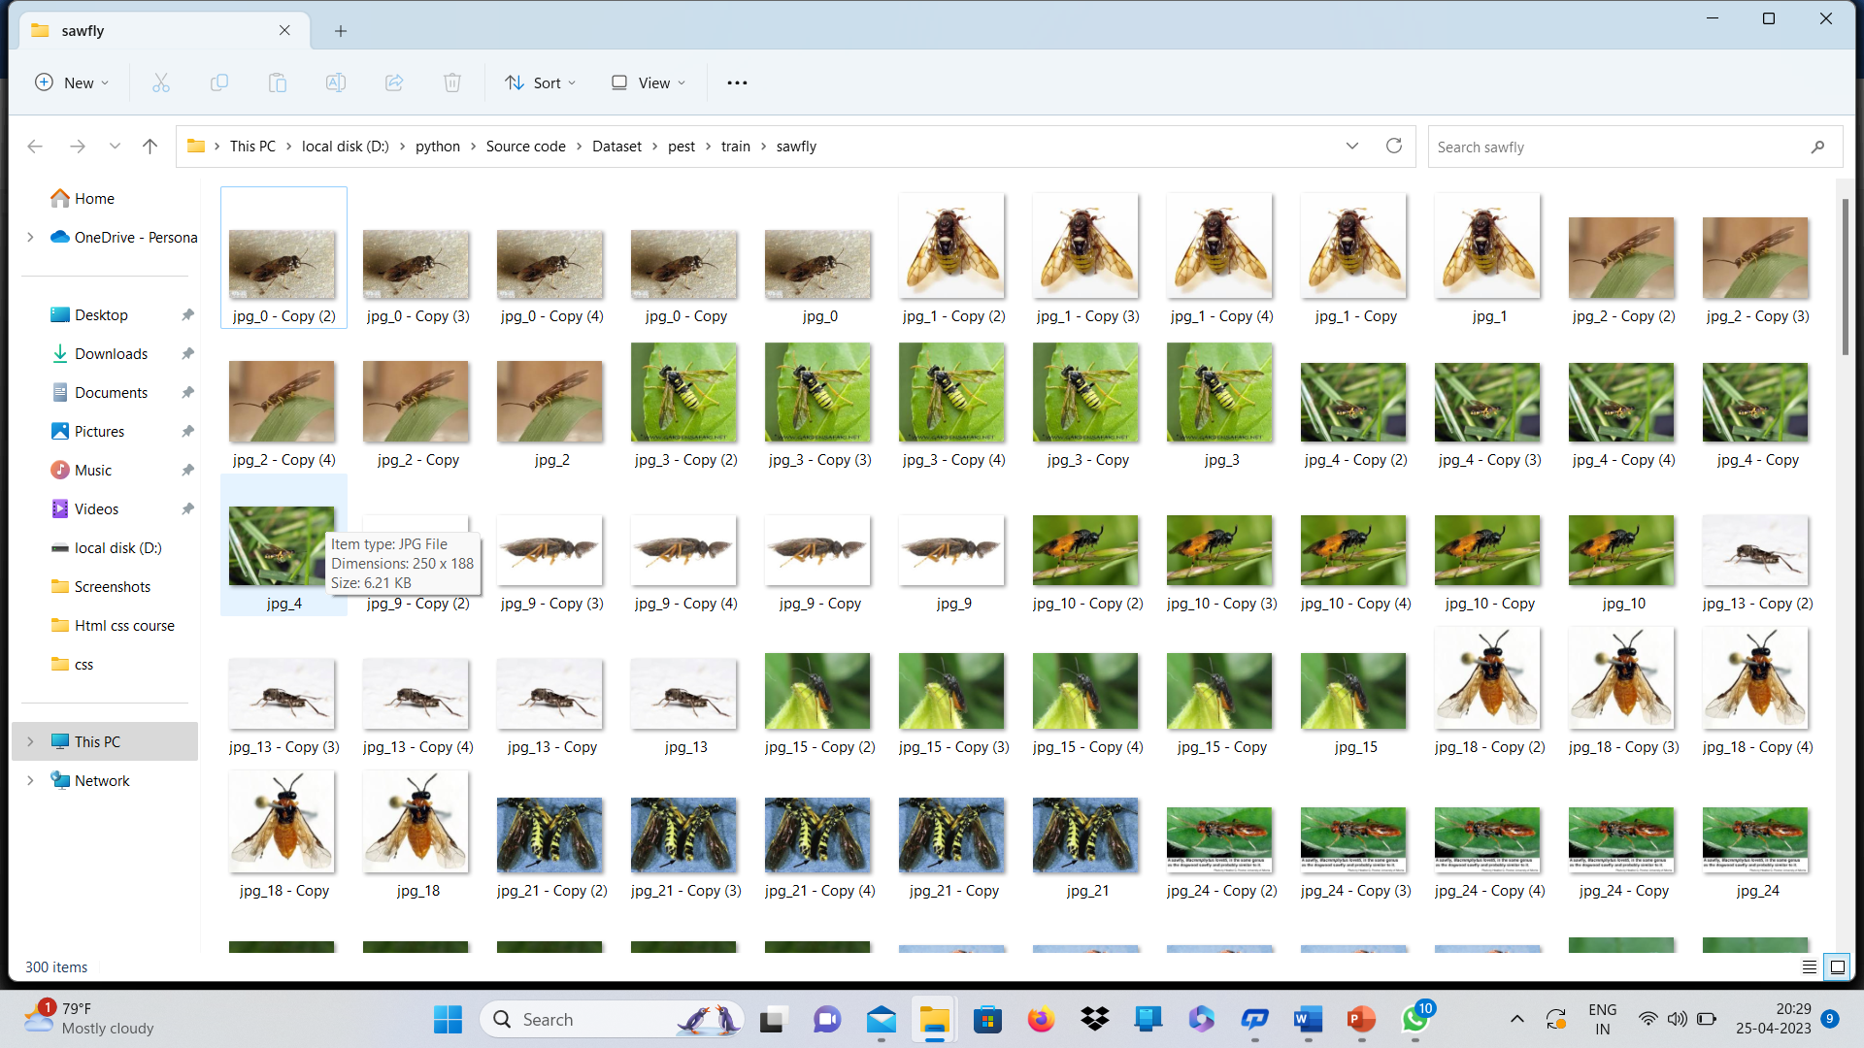
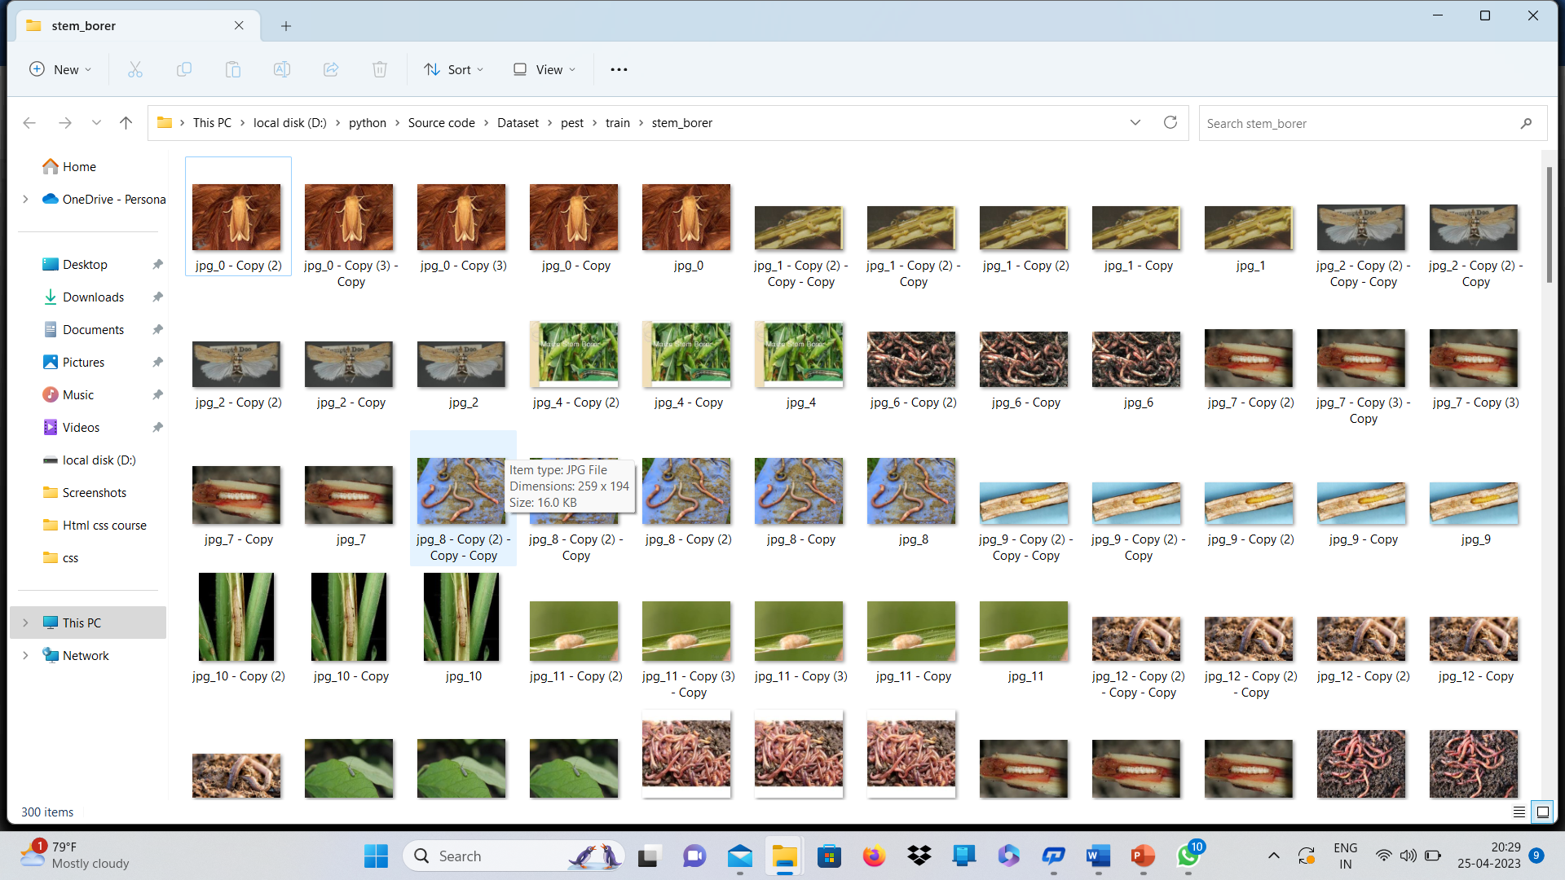
DATASET
The Datasets are Collected from the Kaggle website.

Slide 9
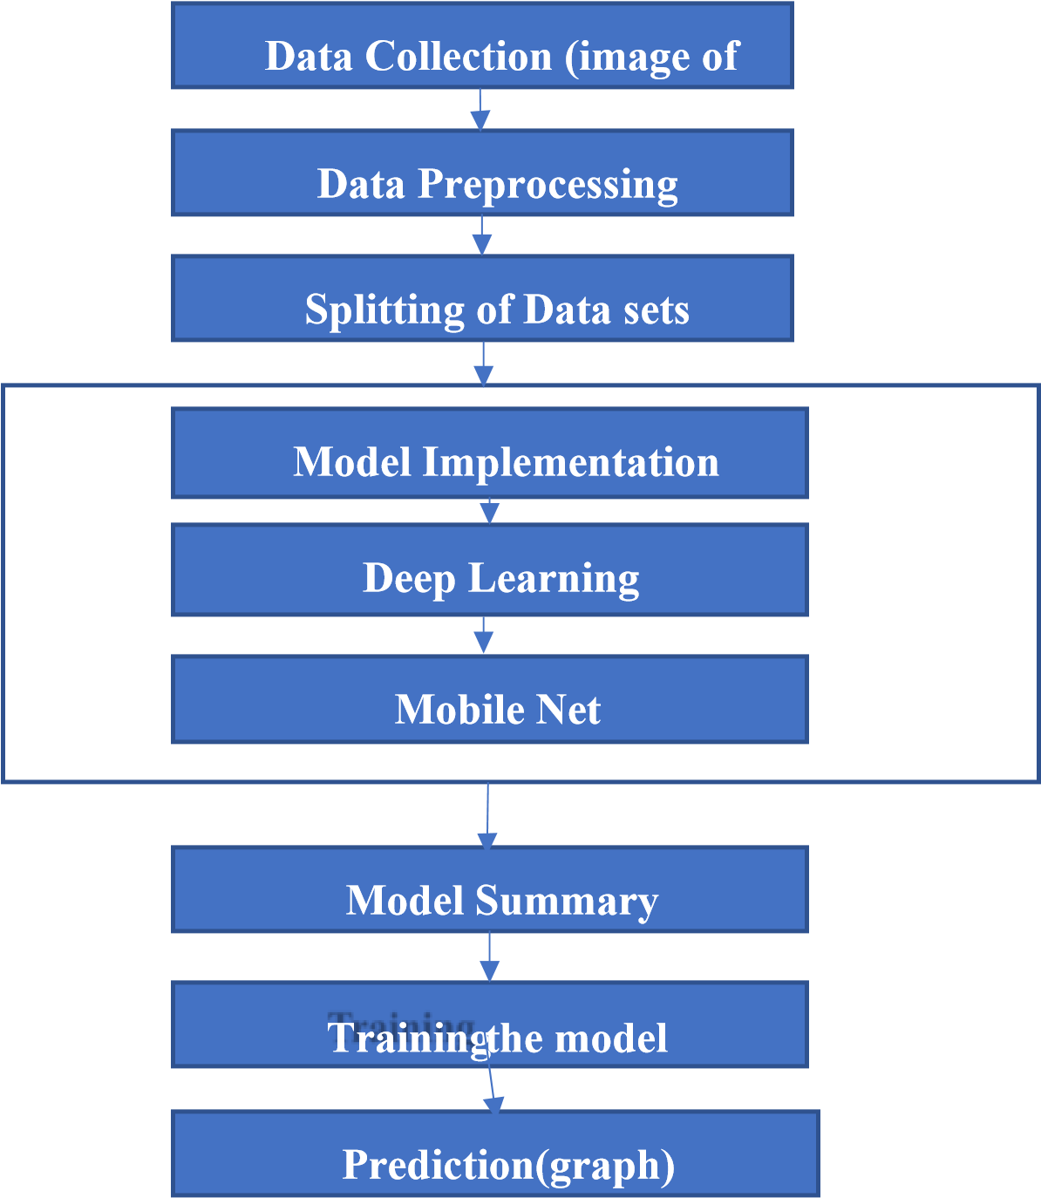
SYSTEM ARCHITECTURE

Slide 10
SYSTEM MODULES
Module 1: Dataset collection
Module 2: Pre-Processing
Module 3: Implementation of Model.
Module 4: Training the model.
Module 5: prediction

Slide 11
SYSTEM TESTING
UNIT TESTING
INTEGRATION TESTING

Slide 12
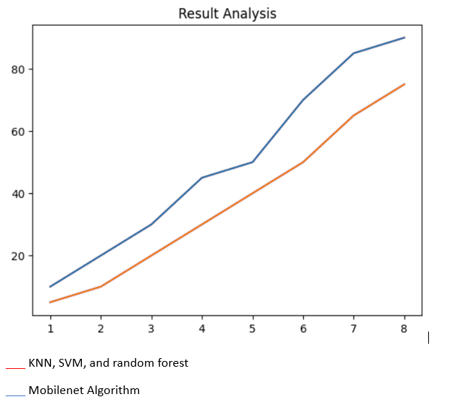
RESULT ANALYSIS
S.NO | Algorithms | Accuracy
1 | KNN,SVM and random forest algorithms | 75%
2 | Mobilenet Algorithm | 90.1%

Slide 13
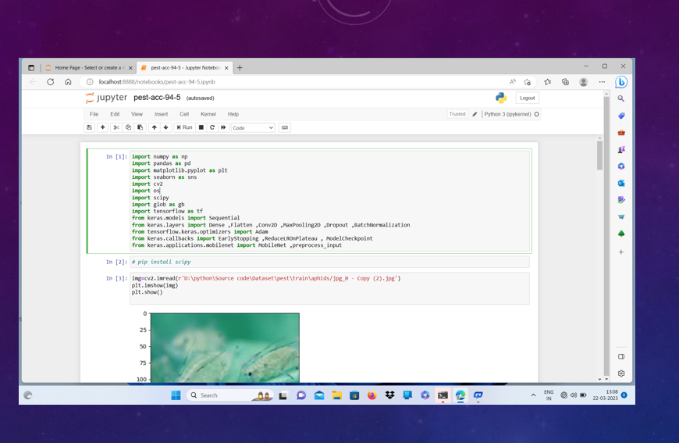
SCREEN SHOTS

Slide 14
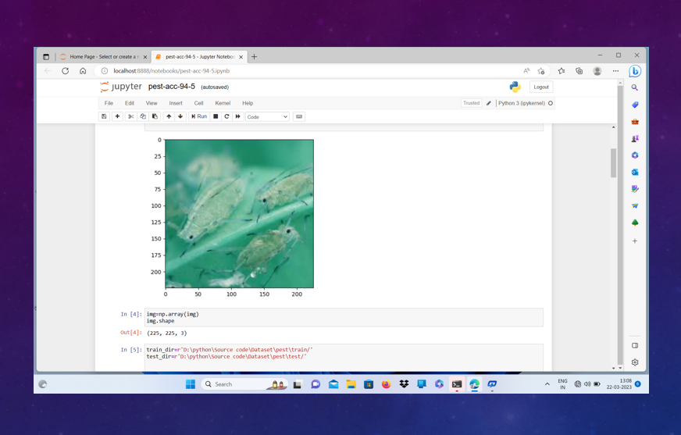
SCREEN SHOTS

Slide 15
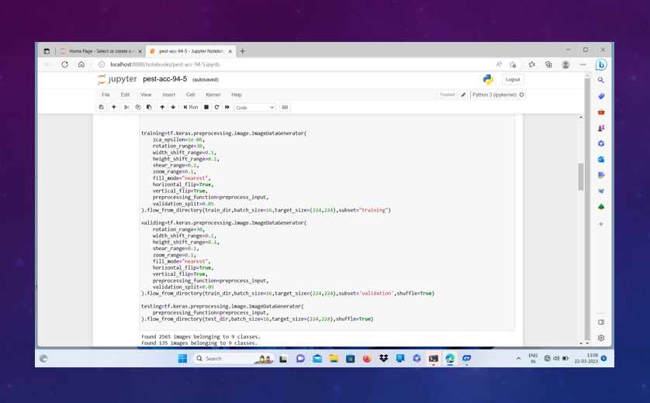
SCREEN SHOTS

Slide 16
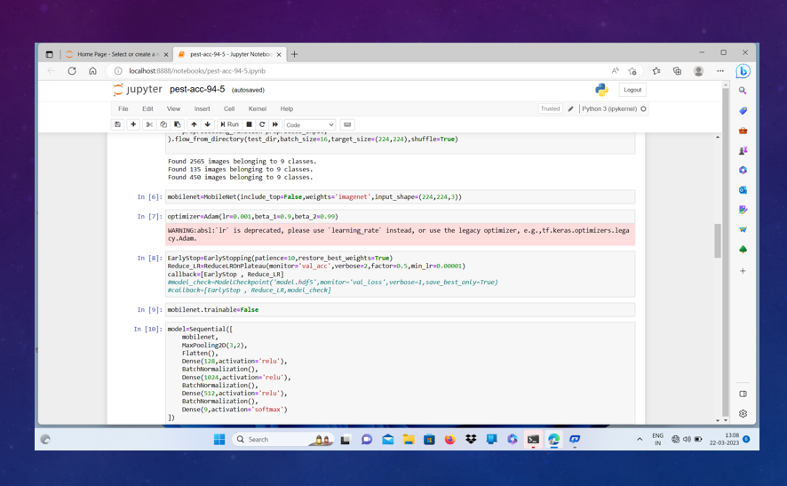
SCREEN SHOTS

Slide 17
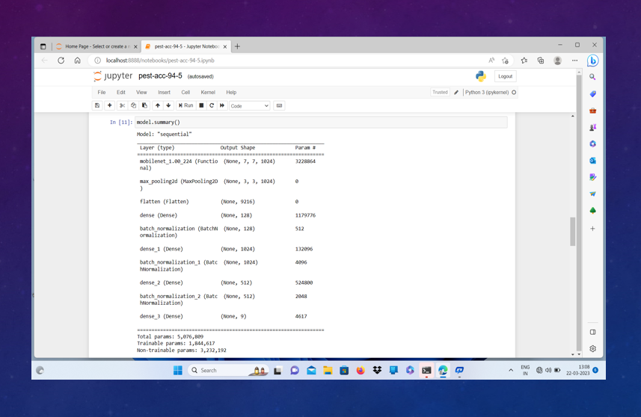
SCREEN SHOTS

Slide 18
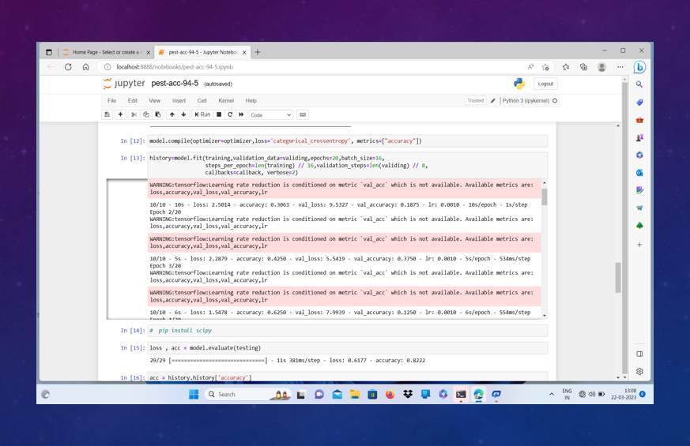
SCREEN SHOTS

Slide 19
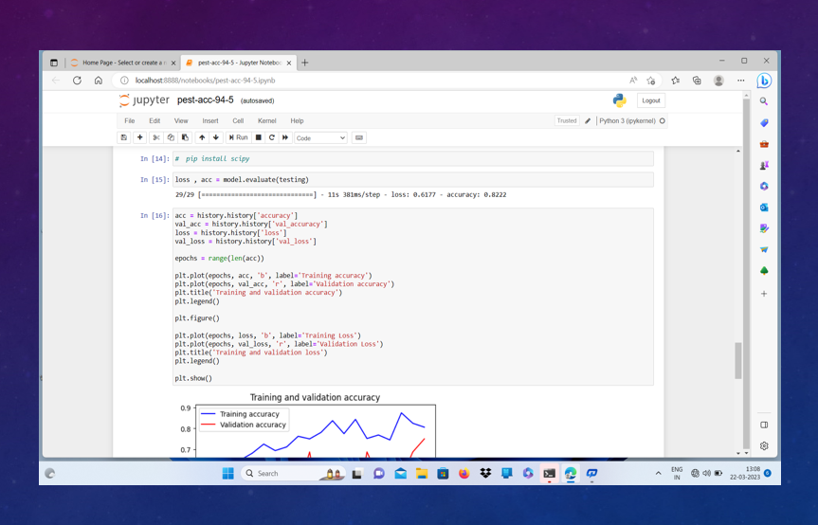
SCREEN SHOTS

Slide 20
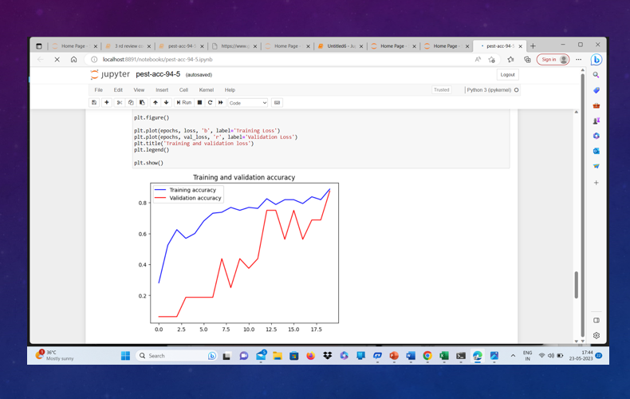
SCREEN SHOTS

Slide 21
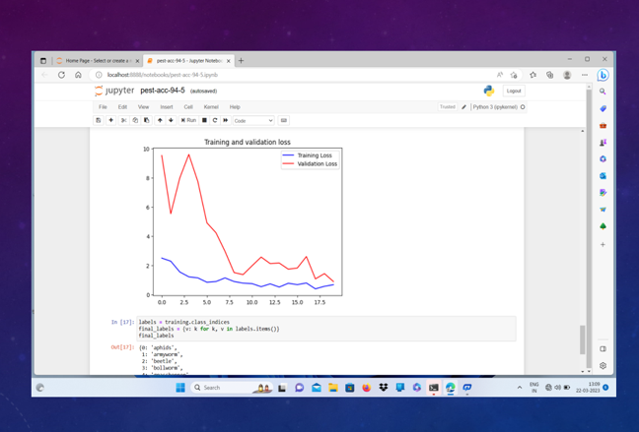
SCREEN SHOTS

Slide 22
MERITS
Easy detection of the insect with the concluded technique.
Best accuracy Model helps in better treatment as early.
Smaller and Faster.
LIMITATIONS
The existing system used different algorithm to predict the insect, but accuracy is low comparison of our model.
Feature Extraction is very complex.
Time Consuming

Slide 23
CONCLUSION
This project illustrates an automatic approach for pest detection using Deep learning
The core objective of the research is to enhance feature extraction phase to improve the detection efficiency.
The experiment result has proven the effectiveness of the new algorithm in dealing with multi-class pest data.

Slide 24
FUTURE ENHANCEMENT
The proposed research can be extended by using a larger dataset of images of fluffy caterpillar and consequently using deep learning techniques. The presented research work can be further extended by incorporating the images of different pests. The proposed approach can be integrated with Internet of Things or Wireless Sensor Networks to develop a real time pest monitoring system. However, the proposed research work is developed with less images due to resource constraints.

Slide 25
BIBLIOGRAPHY
Press Trust of India. (2009, Feb 26). India loses Rs 90k-cr crop yield to pest attacks every year [Online]. Available: http://www. financialexpress.comlnews/india-Ioses-rs-90kcr-cropyield-to-pestattacks-every-year 14280911.
Ganesh Bhadane, Sapana Sharma and Vijay B. Nerkar, "Early Pest Identification in Agricultural Crops using Image Processing Techniques", International Journal of Electrical, Electronics and Computer Engineering, 2(2), 2013, pp. 77-82.
R. K. Samanta and I. Ghosh, “Tea insect pests classification base on artificial neural networks,” International Journal of Computer Engineering Science, vol. 2, June 2012.

Slide 26
Thank you

